Slide 1
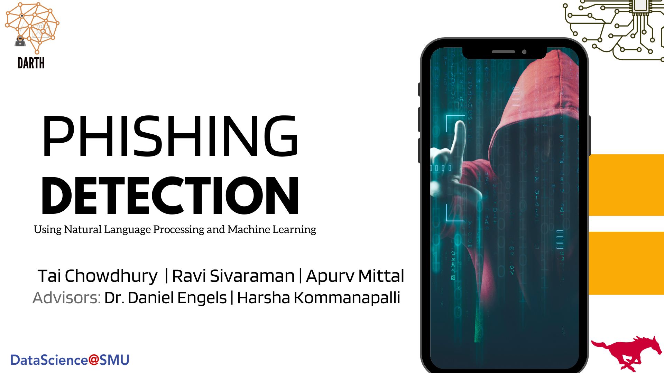
Notes:
Hello Everyone! I am Tai Chowdhury. I am here with Apurv Mittal and Ravi Sivaraman.
Our advisors are Dr. Engels who is a pioneer in cybersecurity and ex-SMU professor and Harsha an SMU alumnus, currently working at Meta.
Our topic is Phishing Detection using Natural Language Processing and Machine Learning.
We are going to share a novel approach on phishing detection today

Slide 2
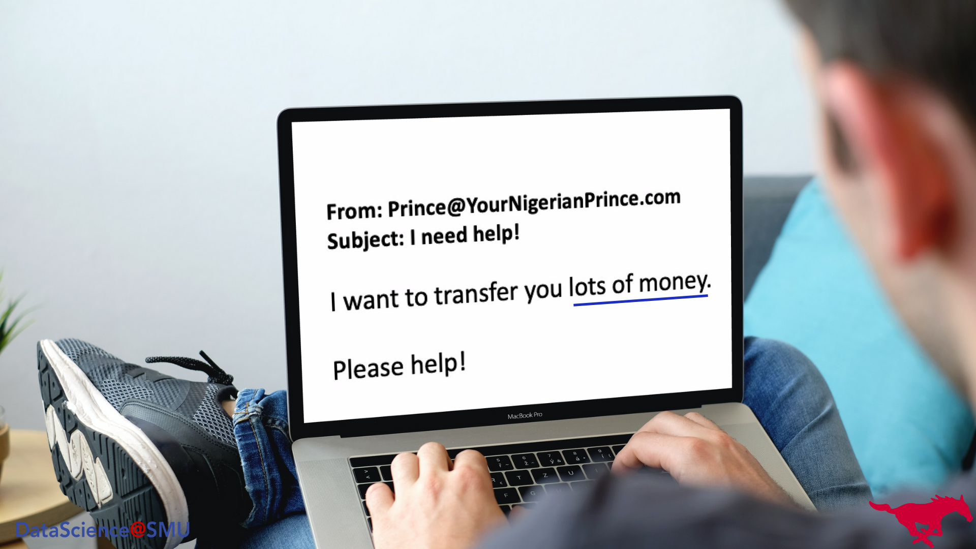
Notes:
We all have received an email like this where somebody asked us for money or offer incentive.
When we take an action by replying to email, clicking on attached URLs or opening attached file, we run a risk of giving access to our system to the hackers.
This is an example of phishing.
It is an act of stealing information by inducing an individual to reveal personal or sensitive information.

Slide 3

Notes:
There are three different channels attackers use to target victims such as text messages, webpages, and webmail.
Our focus is on webmail since it continues to be among the top methods of phishing attempts.
These attacks costs greatly to individuals and organizations around the world.

Slide 4
Attacks in 1st quarter of 2022. ¹
Losses per minute due to phishing attacks in 2022. ²
1.02 Million
$17k
1st quarter 2022 - docs.apwg.org. (n.d.). Retrieved June 22, 2022, from https://docs.apwg.org/reports/apwg_trends_report_q1_2022.pdf
2. Sjouwerman, S. (n.d.). This year, phishing causes losses of $17,700 per minute and ransomware attacks will cost $22,184 per minute. Blog. Retrieved June 21, 2022, from https://blog.knowbe4.com/this-year-phishing-causes-losses-of-17700-per-minute-and-ransomware-attacks-will-cost-22184-per-minute
Notes:
1. Just during the 1st quarter of THIS YEAR ALONE, there have been 1.02 MILLION phishing attacks. It is the worst quarter for phishing as observed by the Anti-Phishing Working Group
2. We are dealing with $17k LOSSES PER MINUTE due to phishing attacks in 2022.
3. Since 2019, these attacks cost businesses $5 BILLION DOLLARS PER.
4. Phishing attacks on social media apps are very common these days. 47% Of social media phishing attacks are through LinkedIn as of 2022.

Slide 5
1.02 Million
$17k
Attacks in 1st quarter of 2022. ¹
Losses per minute due to phishing attacks in 2022. ²
$5 Billion
1 in 99
Phishing email attack (2022). ⁴
Cost to businesses per year. ³
3. What is Phishing: How to Protect Your Company from Scams. (n.d.). IRONSCALES. https://ironscales.com/resources/learn/what-is-phishing/
4. Slandau. (2022, April 5). Phishing attack statistics 2022. CyberTalk. Retrieved June 30, 2022, from https://www.cybertalk.org/2022/03/30/top-15-phishing-attack-statistics-and-they-might-scare-you/
Notes:
1. Just during 1st quarter of THIS YEAR ALONE, there has been 1.02 MILLION phishing attacks. It is the worst quarter for phishing as observed by Anti-Phishing Working Group
2. We are dealing with $17k LOSSES PER MINUTE due to phishing attacks in 2022.
3. Since 2019, these attacks costed business $5 BILLION DOLLARS PER.
4. One in 99 emails is a phishing attack. 25% of these emails manage to make their way into Office 365 inboxes.

Slide 6
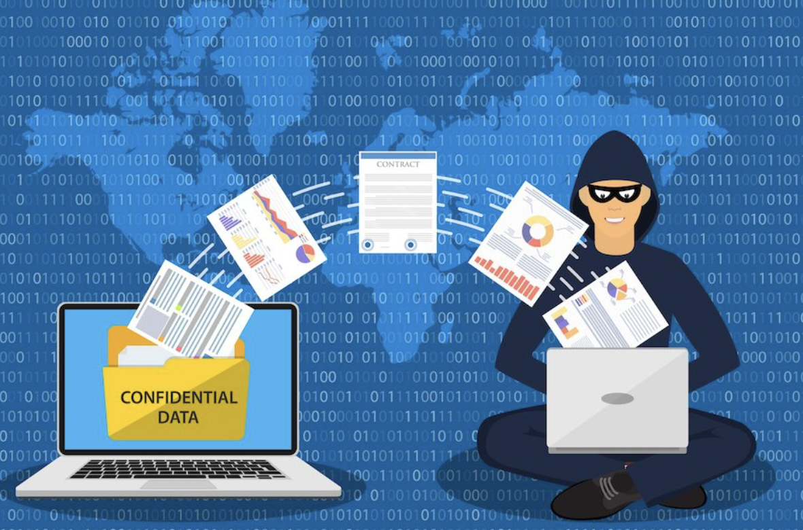
$17k
1.02 Million
Attacks in 1st quarter of 2022. ¹
Losses per minute due to phishing attacks in 2022. ²
47%
$5 Billion
Of social media phishing attacks (2022). ⁴
Cost to businesses per year. ³
Notes:
These are astronomical numbers.
In the digital age, the rise of social media outlets exacerbates the problem greatly since the attackers finds various ways to reach out to potential victims.
Also, they can build sophisticated tools or apply creative methods for infiltrating through victims’ systems

Slide 7
Problem Statement
To identify and detect the phishing email before it makes it to the User.
Notes:
These attacks bring uncertainties, anxieties, and great harm to people in this modern age.
To tackle this issue, our goal is to automatically identify phishing attacks before it makes it to the user.
To do so it is important to breakdown all the features of emails.

Slide 8
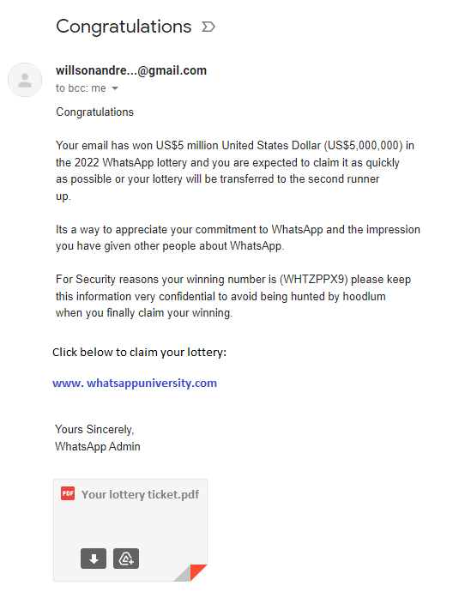
Body Text
Notes:
They are email body text, embedded URLs, metadata, and attachments
(THEN BRING OUT THE BOX AROUND TEXT)
Here we have an example of email body text.
This is where the attackers try to induce victims through strong and creative messages.
Sometimes, they use different companies email template to make it look legitimate.
This may make the victims to act.

Slide 9
URL
Notes:
Here is an example of URLs
This is where the victim unintentionally provides unauthorized access to his or her sensitive information.
The attackers name these URLs in a way that makes it look credible

Slide 10
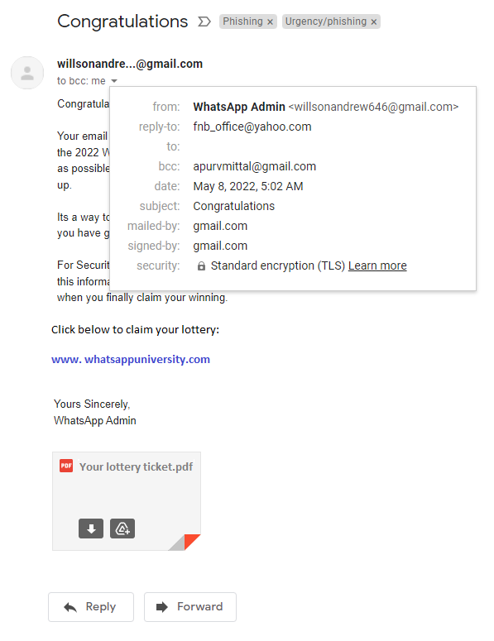
Metadata
Notes:
After that we have metadata.
This is where attackers try to further establish credibility using legitimate companies’ email domains.

Slide 11
Attachment
Notes:
Finally, there is attachment
If victims access the document or a file, the hacker can establish malwares or sophisticated bugs which will provide access to victims’ operating system.

Slide 12
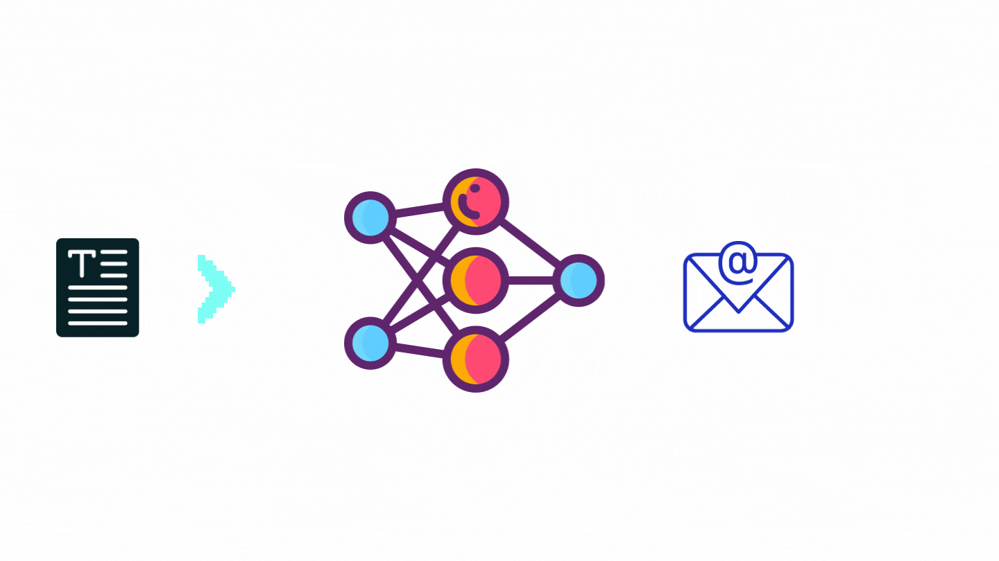
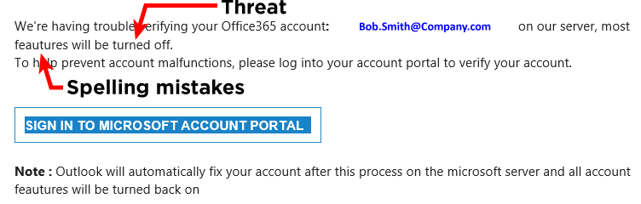
Traditional Approach – Body text
Email Body Text :
Graph Convolutional Network ⁵
Topic Modeling ⁶
5. Alhogail, & Alsabih, A. (2021). Applying machine learning and natural language processing to detect phishing email. Computers & Security, 110, 102414–. https://doi.org/10.1016/j.cose.2021.102414
6. Devlin, J., Chang, M. W., Lee, K., & Toutanova, K. (2018). Bert: Pre-training of deep bidirectional transformers for language understanding. arXiv preprint arXiv:1810.04805
Notes:
Phishing detection has been popular topic among researchers.
spelling errors, grammatical errors, threats etc. in the email body can help identify phishing attempt.
researchers in past have used various methods to identify malicious email from body text with success rates going up to mid 90s.

Slide 13

Traditional Approach - url
www.amazonsprimes.com
www.netflixaccount.com
www.appleiphone.net
www.googlespay.com
URLs :
Blacklists ⁷
CNN ⁸
Random Forest ⁹
7. Abu-Nimeh, S., et al. “Distributed Phishing Detection by Applying Variable Selection Using Bayesian Additive Regression Trees.” 2009 IEEE International Conference on Communications, IEEE, 2009, pp. 1–5, https://doi.org/10.1109/ICC.2009.5198931.
8. Wei, Ke, Q., Nowak, J., Korytkowski, M., Scherer, R., & Woźniak, M. (2020). Accurate and fast URL phishing detector: A convolutional neural network approach. Computer Networks (Amsterdam, Netherlands: 1999), 178, 107275–. https://doi.org/10.1016/j.comnet.2020.107275
9. Akinyelu, Ayo & Adewumi, Aderemi. (2014). Classification of Phishing Email Using Random Forest Machine Learning Technique. Journal of Applied Mathematics. 2014. 10.1155/2014/425731.
Notes:
Similarly, Embedded URLs is another popular feature used for phishing detection.
Blacklisting of URLs has been used traditionally. However, its not very successful as attackers are constantly updating the URLs.
Various other models have been built around this with success rates going up to high 90s.

Slide 14

Traditional Approach - metadata
Metadata :
Logistic Regression ¹⁰
XGBoost ¹⁰
Random Forest ⁹
10. Detection of Phishing Websites Using Ensemble Machine Learning Approach Dharani M., Soumya Badkul, Kimaya Gharat, Amarsinh Vidhate and Dhanashri Bhosale ITM Web Conf., 40 (2021) 03012
Notes:
As discussed earlier the email Metadata is a very important feature.
In fact, we feel it’s one of the most important features of an email as it contains sender detail, how it was routed, etc., and can be used in identifying malicious emails.
Prior researchers have used metadata and in combinations with other features like URLs with success rates going up to the mid to high 90s.

Slide 15
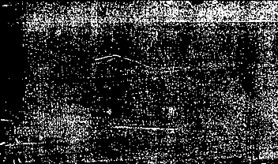




But they still get through…..
Notes:
BUT THEY STILL GET THROUGH….
Even if only 1% get through, we have BILLIONS of dollars in losses every year.
WE need BETTER approach. AND There is a better way of doing it.

Slide 16


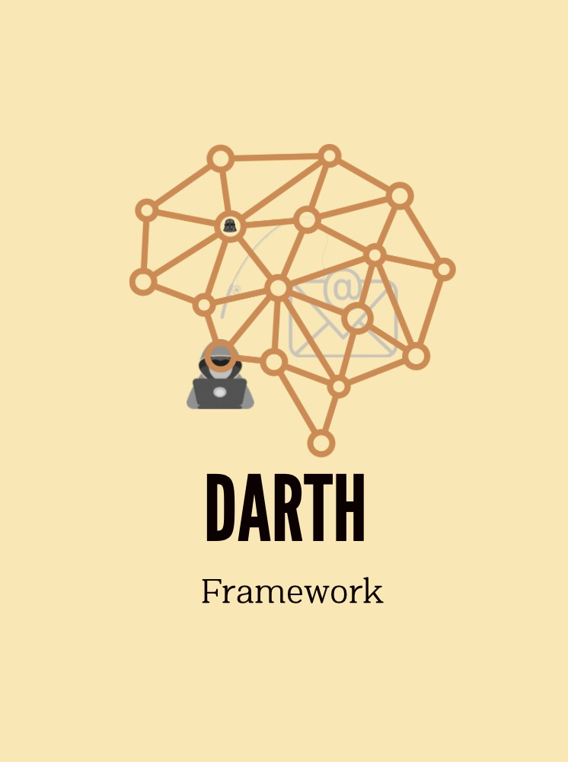
Take over THE DARK SIDE
Picture from www.kisspng.com/free/darth-vader.html
Sound from Zapsplat.com
Notes:
We know the power of the Dark Side and we can stop it, Introducing the DARTH Framework. It is time to take on the Dark Side.
Source Image :
Background : https://wallpaperplay.com/board/star-wars-wallpapers
Picture:
https://www.kisspng.com/free/darth-vader.html
Sound from Zapsplat.com
We have developed the DARTH Framework to take over the Dark
Intro to darth
Developed a model for each composite features then took results of these models to combine into a final ensemble model that takes output from each model and yields a final classification

Slide 17
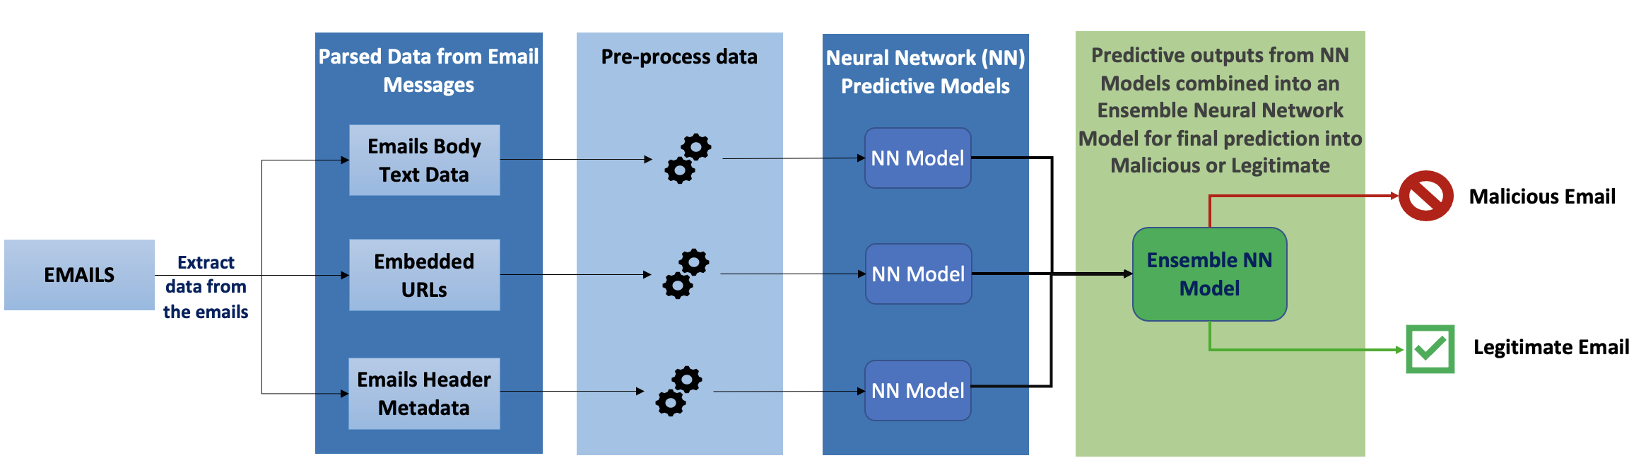
EMAILS
Notes:
Even though DARTH framework can be applied any form of phishing detection
Our focus here is on email phishing detection.
Let’s start with Emails to understand how the DARTH framework works.

Slide 18
Parsed Data from Email Messages
Emails Body Text Data
EMAILS
Embedded URLs
Emails Header Metadata
Notes:
First we extract the important composite features from the emails.
Like the Body Text which most of us are very familiar with.
Then the embedded URLs in the email, they are not just in the body of the email but also sometimes in the metadata.
And one of the most important composite feature metadata.

Slide 19

Parsed Data from Email Messages
Pre-process data
Emails Body Text Data
EMAILS
Embedded URLs
Emails Header Metadata
Notes:
After data extraction, it needs to be pre-processed before modeling.
Body text is cleaned and vectorized.
The URLS are further extracted for features like top domain, subdomain, suffix, the length of the URL etc. We extracted up to 87 features from the URLs.
Similarly, metadata are broken down and categorized.

Slide 20
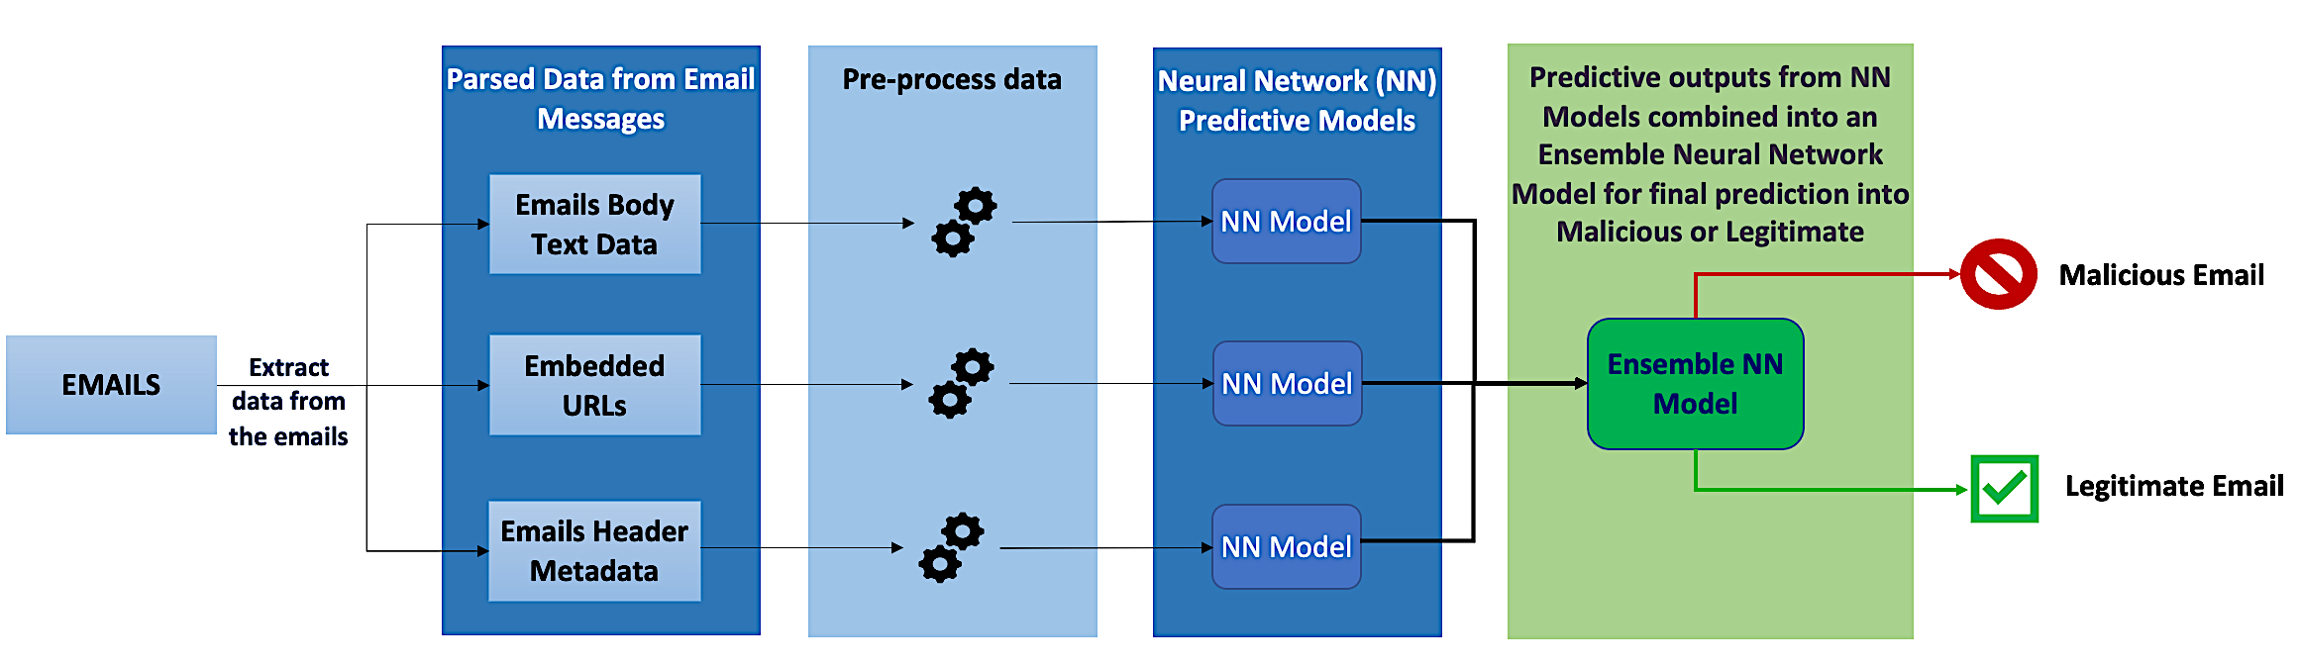
Notes:
After preprocessing, the data is fed into individual neural network models for predictions.
For Body Text we use popular transfer learning from BERT.
Each Neural Network model is individually predicting the same email as malicious or not based on its own data.
The predicted outputs from the NN models are combined into an Ensemble Neural Network Model for final prediction.

Slide 21
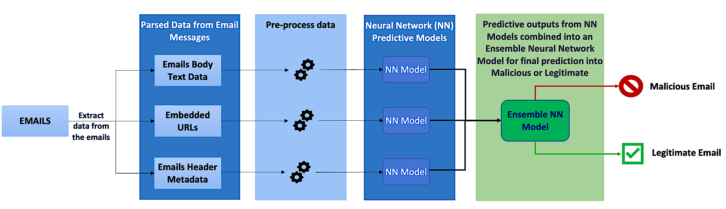
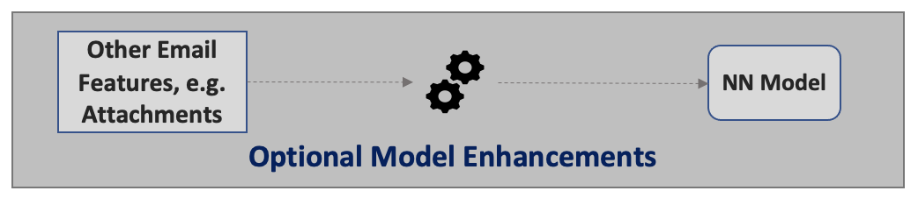
DARTH Framework
Notes:
The final ensemble model makes the prediction on the email is Malicious or Legitimate.
This is not all, we can add additional features models to the framework.
Like Attachments, we calculated the entropy for different document types. If the attached entropy falls outside the normal range, then it raises the suspicion of the document being malicious.
And THAT is THE DARTH Framework.

Slide 22
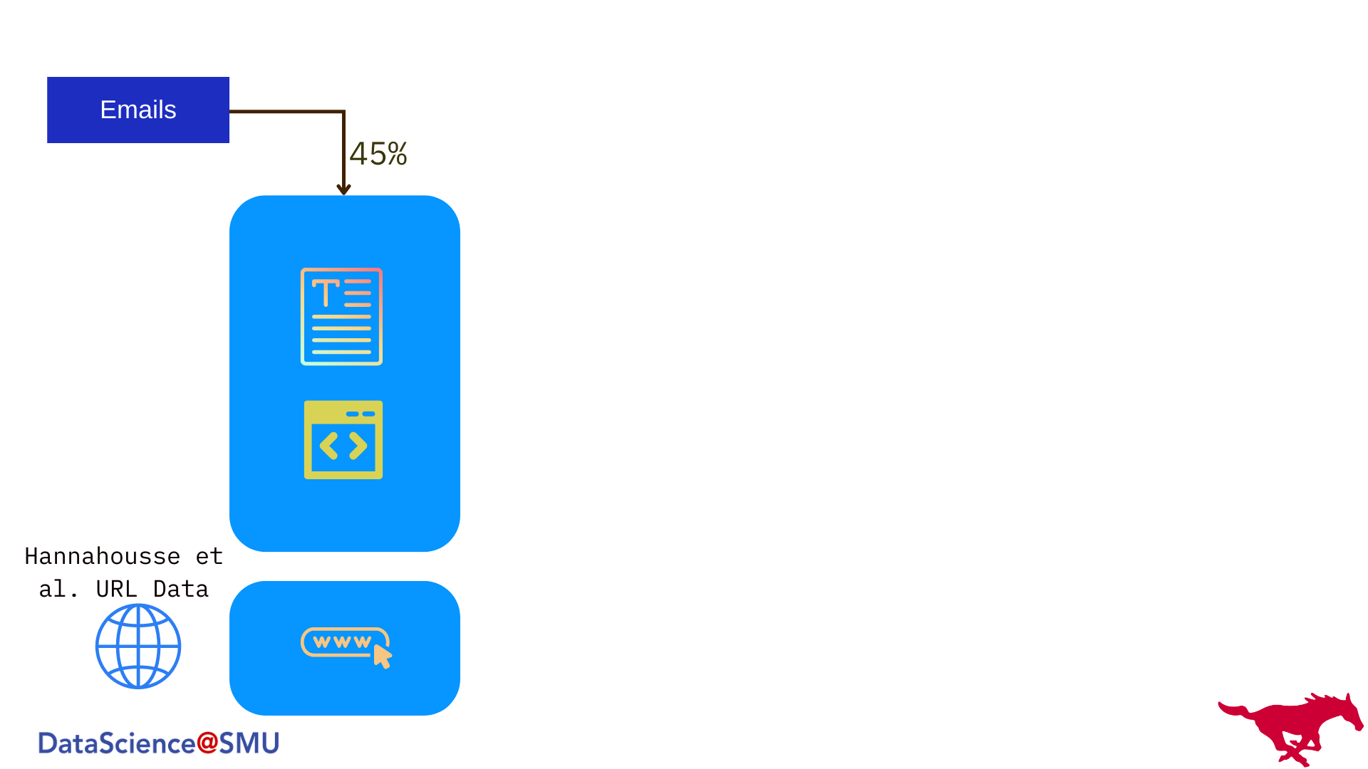
Model Training
Notes:
Data for our models come from our own emails, over 55,000 of them. We split them by 90/10 for training and validation.
90% of training data is further split into two,

Slide 23
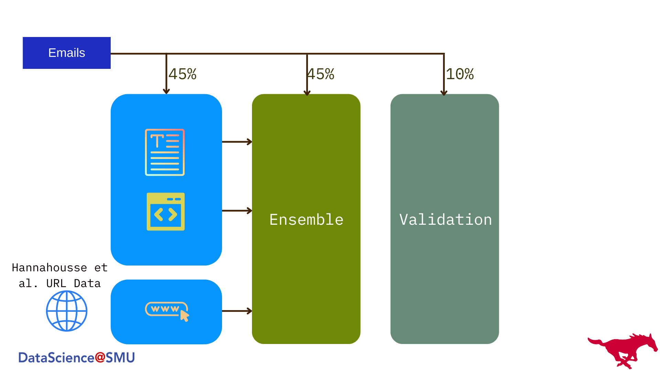
Model Training
Notes:
For individual composite models and final ensemble.
We also make use of external data that aids our cause,
here is the, confirmed phishing URL data and incorporate it into our framework.

Slide 24
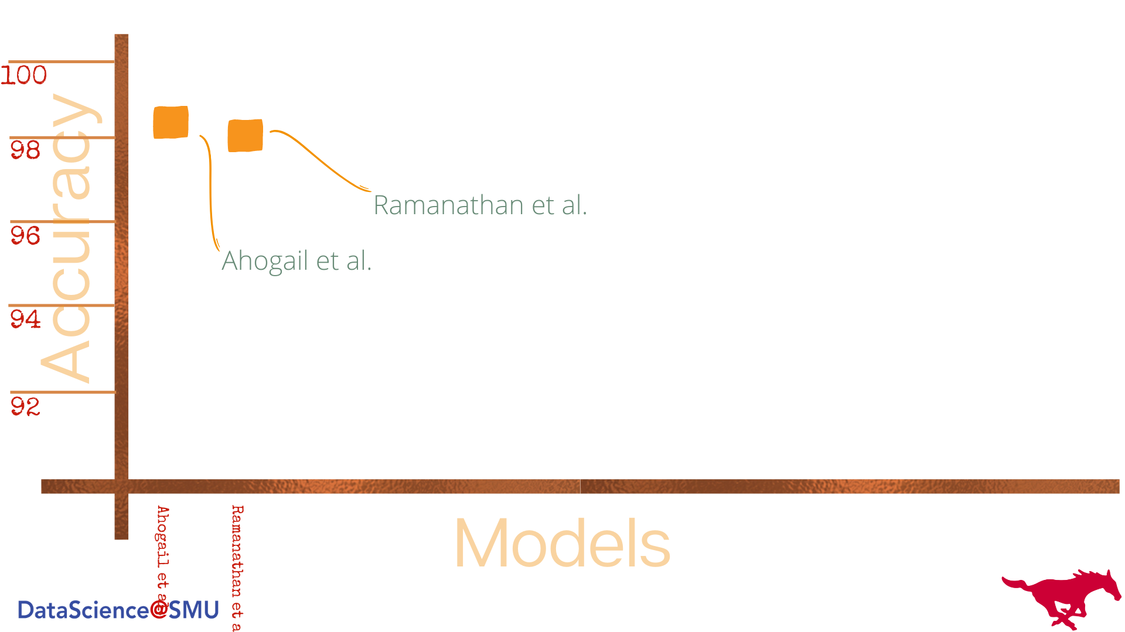
Results
Notes:
Lets see the results, first --- the prior research models.
These two prior models use body text for models.
As you can see they hover around the high 90s.

Slide 25
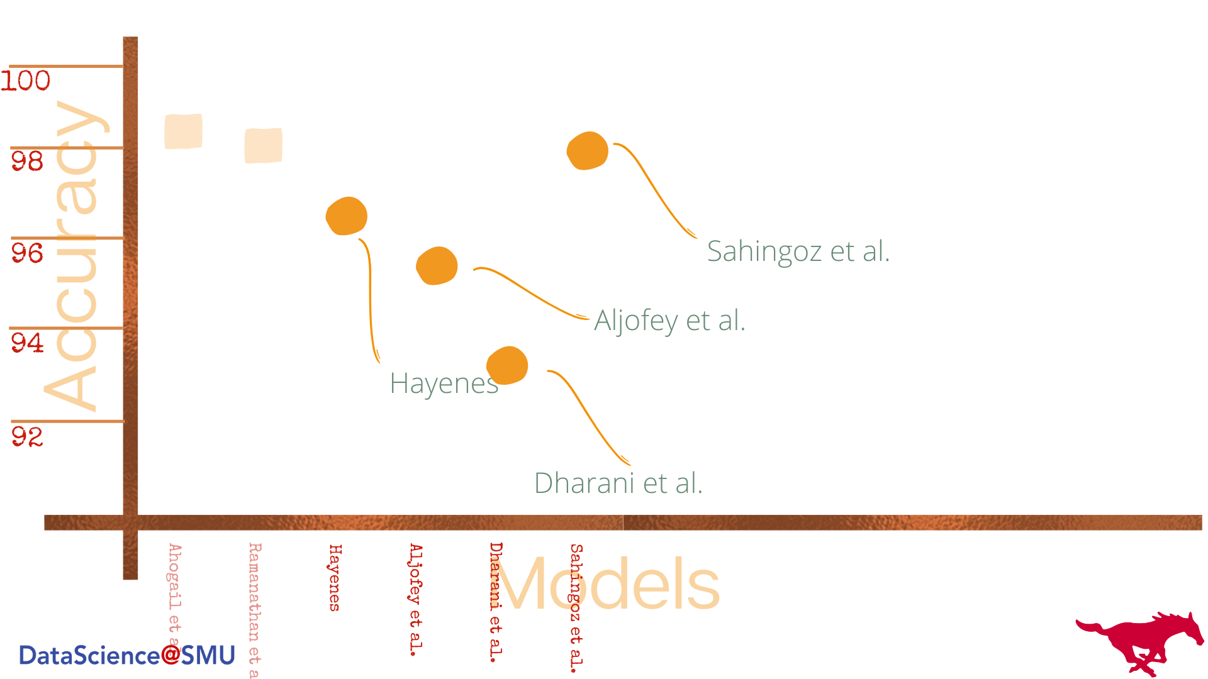
Results
Notes:
These are prior models using URLs.
These models’ accuracy goes up to the high 90s as well.
This is good, but certainly, there is room for improvement.

Slide 26
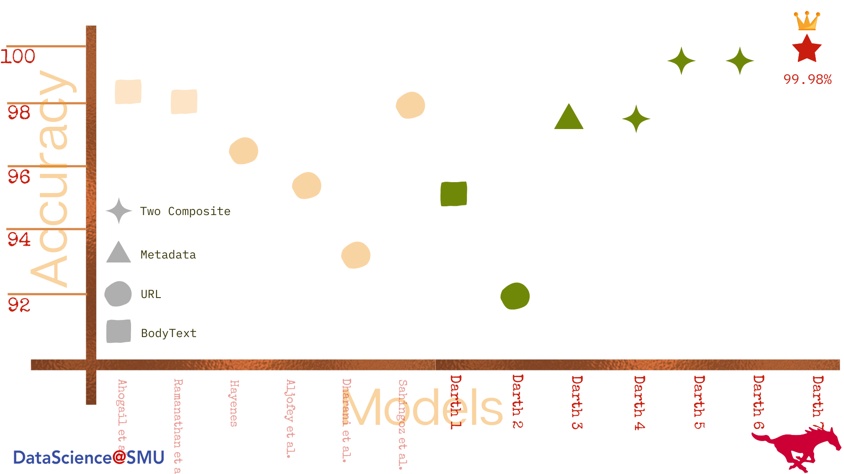
Results
Notes:
Lets see our darth models- which is green , this is based on urls, in the low 90s.
this one is using only body text is in the mid-90s
The next one is the metadata, so overall, nothing to write home about.
Now, we combine two composite features, like URL and metadata, and their combination has increased that of individuals.
What happens when we add all composite models to the final ensemble? It goes all the way to 99.98%, a great result just by adding more composite features to the mix.

Slide 27
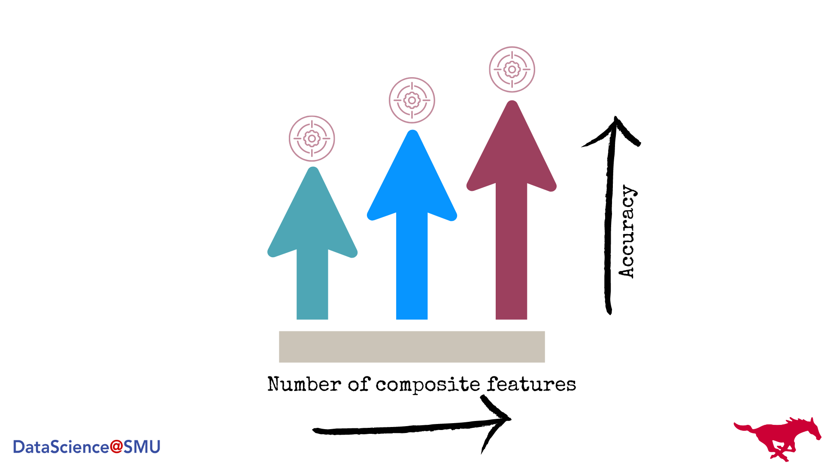
Conclusion
Notes:
Adding more composite features, increased the accuracy, and it kept increasing.
Even less accurate models contributed overall, with great results for Darth.
Using Darth models, by the previous estimates, we can save over $4 billion dollars every year!

Slide 28
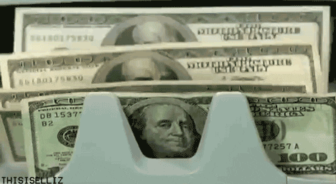

Gif from Giphy.com
Sound from Zapsplat.com

Slide 29
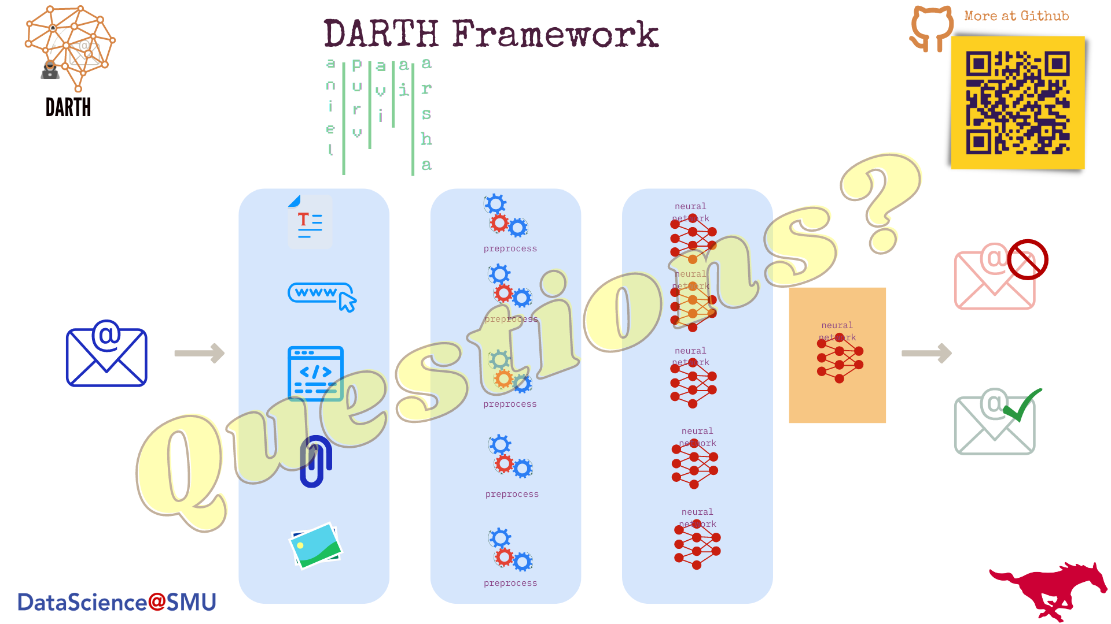
Notes:
Thanks!

Slide 30
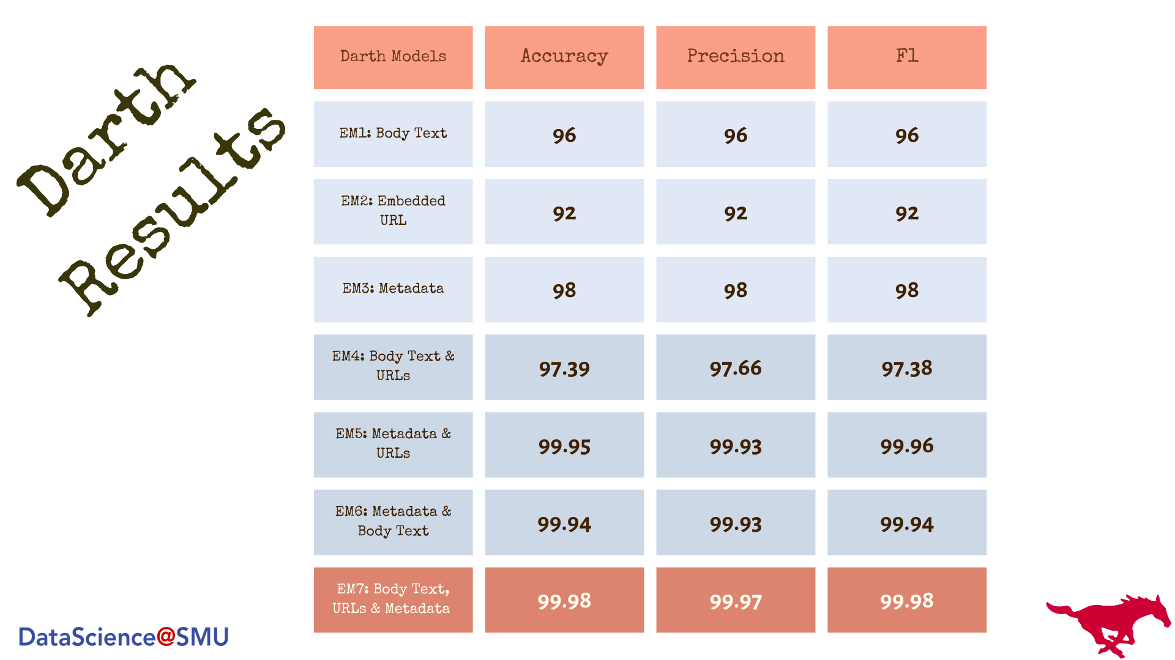
Notes:
Results of our Darth Models with Accuracy, Precision, and F1-score.
The results show that with more composite features, the accuracy gets better.

